Slide 1




Affirma consulting is the consulting firm that cares. Our strength is in our passionate, knowledgeable and happy team members. We believe and are living proof that when you take care of your employees – they will take care of your customers. Our team members care about your project success – and it shows.
See how their enthusiasm and knowledge can benefit you!

Slide 2
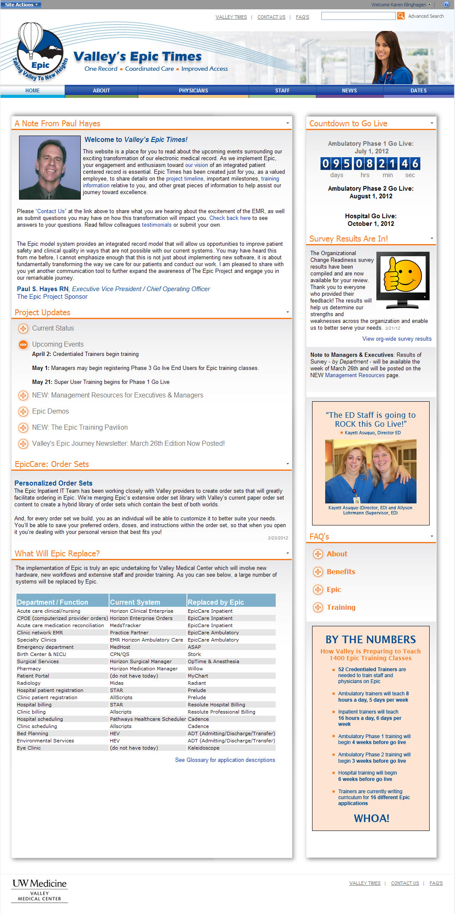
UW's Valley Medical Center Intranet
The Challenge
The UW Medicine’s Valley Medical Center needed a customized portal that would allow for better management of information about various internal projects. The client was interested in leveraging the capabilities of SharePoint without having the standard SharePoint look and feel.
What We Did
Our team developed a SharePoint Intranet, complete with fully- customized functionality, branding, and design. Adhering to brand guidelines, we created a seamless, non-SharePoint looking portal experience designed to provide the best user-experience possible.
Results
The goal of this project was to enhance efficiency and productivity by providing end-users with a single access point for mission-critical information. The resulting Intranet has been praised by end-users for the drastic enhancements to usability.

